Slide 1
Acts 2 : 22 - 41

Slide 2
²² “Men of Israel, hear these words: Jesus of Nazareth, a man attested to you by God with mighty works and wonders and signs that God did through him in your midst, as you yourselves know— ²³ this Jesus, delivered up according to the definite plan and foreknowledge of God, you crucified and killed by the hands of lawless men. ²⁴ God raised him up, loosing the pangs of death, because it was not possible for him to be held by it.

Slide 3
²⁵ For David says concerning him,
“ ‘I saw the Lord always before me,
for he is at my right hand that I may not be shaken;
²⁶ therefore my heart was glad, and my tongue rejoiced;
my flesh also will dwell in hope.
²⁷ For you will not abandon my soul to Hades,
or let your Holy One see corruption.
²⁸ You have made known to me the paths of life;
you will make me full of gladness with your presence.’

Slide 4
²⁹ “Brothers, I may say to you with confidence about the patriarch David that he both died and was buried, and his tomb is with us to this day. ³⁰ Being therefore a prophet, and knowing that God had sworn with an oath to him that he would set one of his descendants on his throne, ³¹ he foresaw and spoke about the resurrection of the Christ, that he was not abandoned to Hades, nor did his flesh see corruption. ³² This Jesus God raised up, and of that we all are witnesses. ³³ Being therefore exalted at the right hand of God, and having received from the Father the promise of the Holy Spirit, he has poured out this that you yourselves are seeing and hearing.

Slide 5
³⁴ For David did not ascend into the heavens, but he himself says,
“ ‘The Lord said to my Lord,
“Sit at my right hand,
³⁵ until I make your enemies your footstool.” ’
³⁶ Let all the house of Israel therefore know for certain that God has made him both Lord and Christ, this Jesus whom you crucified.”

Slide 6
³⁷ Now when they heard this they were cut to the heart, and said to Peter and the rest of the apostles, “Brothers, what shall we do?” ³⁸ And Peter said to them, “Repent and be baptized every one of you in the name of Jesus Christ for the forgiveness of your sins, and you will receive the gift of the Holy Spirit. ³⁹ For the promise is for you and for your children and for all who are far off, everyone whom the Lord our God calls to himself.” ⁴⁰ And with many other words he bore witness and continued to exhort them, saying, “Save yourselves from this crooked generation.” ⁴¹ So those who received his word were baptized, and there were added that day about three thousand souls.

Slide 7
The Resurrection of The Christ
1. Jesus of Nazareth was a Man of God (proved by mighty works, wonders, signs)
2. The execution of Jesus was the definite plan and foreknowledge of God
3. God had decreed that Christ Jesus would be raised (foretold through prophets)
Death could not hold Him
²⁴ God raised him up, loosing the pangs of death, because it was not possible for him to be held by it.
²⁷ For you will not abandon my soul to Hades, or let your Holy One see corruption.
³¹ he foresaw and spoke about the resurrection of the Christ, that he was not abandoned to Hades, nor did his flesh see corruption.
4. Jesus is exalted – at the right hand of God.
Both Lord and Christ
5. The Risen Lord Jesus sends His Holy Spirit
Further proof of the resurrection
6. The cost of rejecting the Lord
Ramifications of siding against the supreme ruler
Killed God’s Son. Oops!
³⁶ Let all the house of Israel therefore know for certain that God has made him both Lord and Christ, this Jesus whom you crucified.”

Slide 8
The Resurrection of The Christ
1. Jesus of Nazareth was a Man of God (proved by mighty works, wonders, signs)
2. The execution of Jesus was the definite plan and foreknowledge of God
3. God had decreed that Christ Jesus would be raised (foretold through prophets)
Death could not hold Him
4. Jesus is exalted – at the right hand of God.
Both Lord and Christ
5. The Risen Lord Jesus sends His Holy Spirit
Further proof of the resurrection
6. The cost of rejecting the Lord
Ramifications of siding against the supreme ruler
Killed God’s Son. Oops!
7. Repent and be baptised (for the forgiveness of sins)
Rejection of Christ is the perversion of our humanity
³⁷ Now when they heard this they were cut to the heart, and said to Peter and the rest of the apostles, “Brothers, what shall we do?” ³⁸ And Peter said to them, “Repent and be baptized every one of you in the name of Jesus Christ for the forgiveness of your sins, and you will receive the gift of the Holy Spirit.
³⁹ For the promise is for you and for your children and for all who are far off, everyone whom the Lord our God calls to himself.”

Slide 9
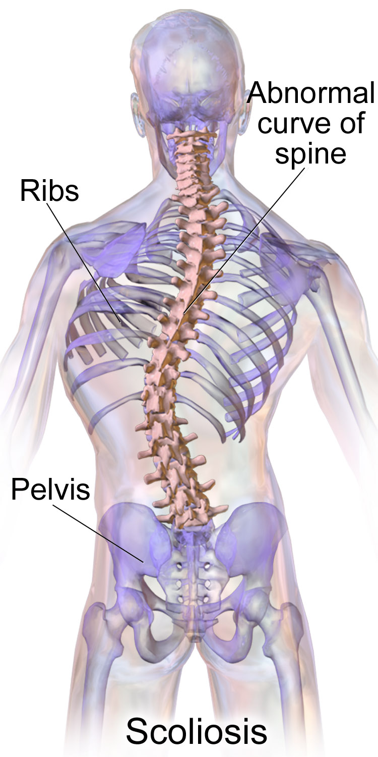
7. Repent and be baptised (for the forgiveness of sins)
Rejection of Christ is the perversion of our humanity
⁴⁰ And with many other words he bore witness and continued to exhort them, saying, “Save yourselves from this crooked generation.”
τῆς γενεᾶς τῆς σκολιᾶς
(tēs geneas tēs skolias)
A crooked / twisted / perverse generation
We were created to be in intimate relationship with God. To reject Christ is perverse / crooked / twisted
To reject Christ, is just as bad as those who crucified Him
God is ready to forgive our prior rejection of Christ
Repent of sin. Be born again. No longer live for ‘self’. Now we live for Christ.
Be Baptised !!! Buried with Christ. Raised to eternal life

